Slide 1
PlanWise
PowerfulDevs Hack TOgether
Soha Jain, Shriya V R, Priyanka Kamakoti

Slide 2
Our App
PlanWise is a Task Planner App built using PowerApps, Power Automate and SharePoint. It enables efficient task scheduling, tracking and completion while encouraging daily planning and helps users build consistent productivity streaks.
Many people fail to plan their day effectively, leading to missed tasks and procrastination. Existing task managers lack accountability and habit-building features.
PlanWise provides a lightweight, structured and automated solution to plan ahead and stay productive.
Integrated with Power Automate for Reminders and Streak Tracking.

Slide 3
How PlanWise works?
Plan your Day -> User create tasks for the next day
Task Status Management -> Tasks start as "Pending" and are marked "Completed" upon Proof of Completion.
Calendar View -> User can view tsks for any selected date.
Automated Reminders -> Mails are sent out to user with Power Automate which ensures timely task tracking.
Streak System -> Completing all the planned tasks for a day increases the streak score.
Key Features – Task Scheduling, Dynamic Task Status, Calendar View, Power Automate Reminders, Streak Tracking

Slide 4
Components
Powerapps – PlanWise
Sharepoint - PlanWise Tasks, Streak
Power Automate - New Task Reminder Mail, Streak Flow
Connectors – SharePoint, Office 365 Outlook, Office 365 Users

Slide 5
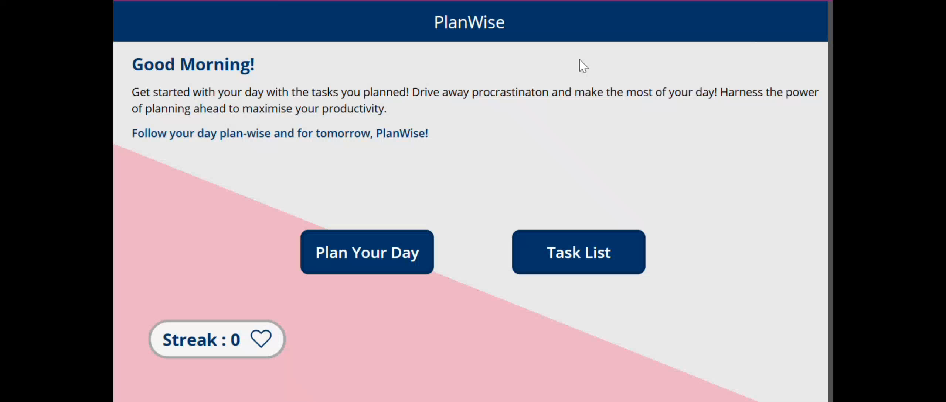
Demo

Slide 6
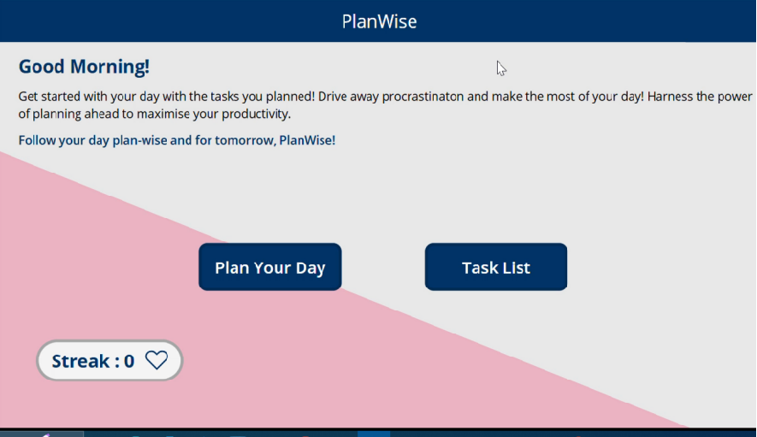
HomePage

Slide 7
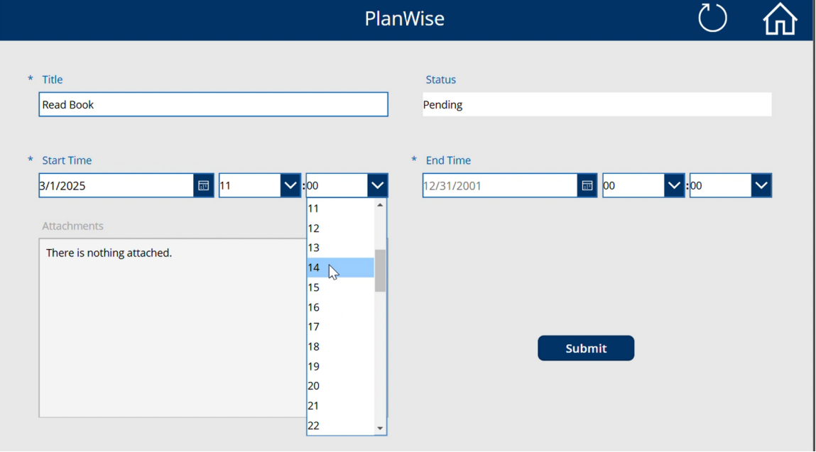
Plan your day – Create Tasks
Add task details -
Title,
Start Time
End Time

Slide 8
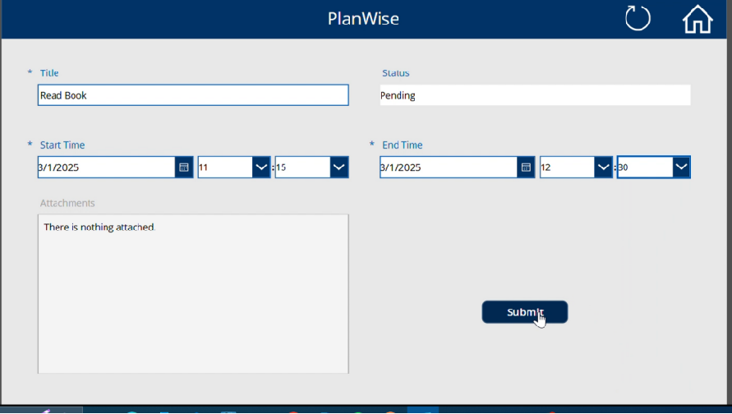
Click on Submit to add task to your day.

Slide 9
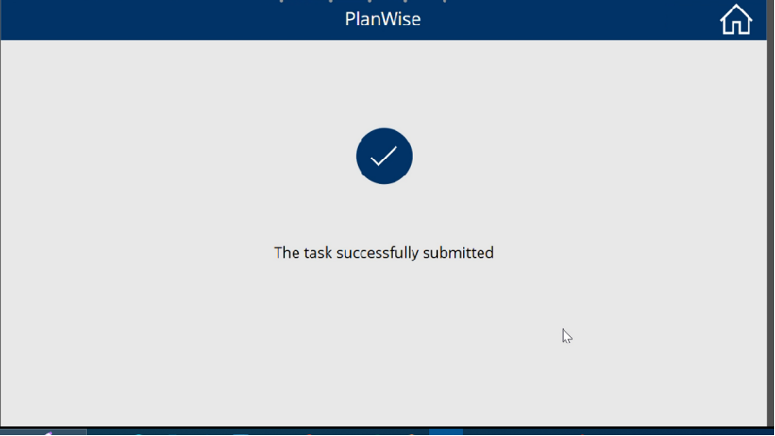
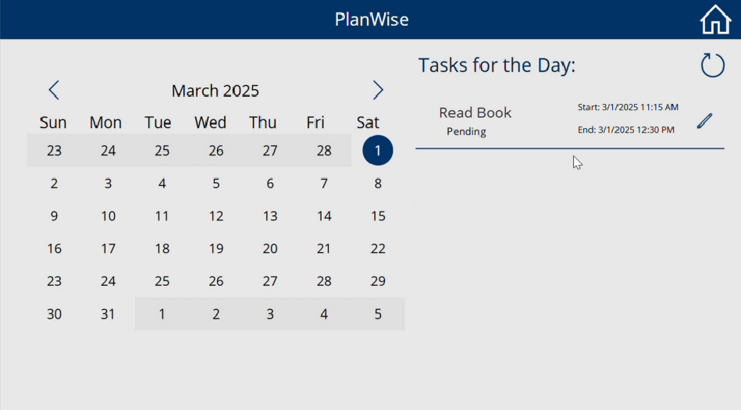
You are redirected to the Success Screen and then to the Task List

Slide 10
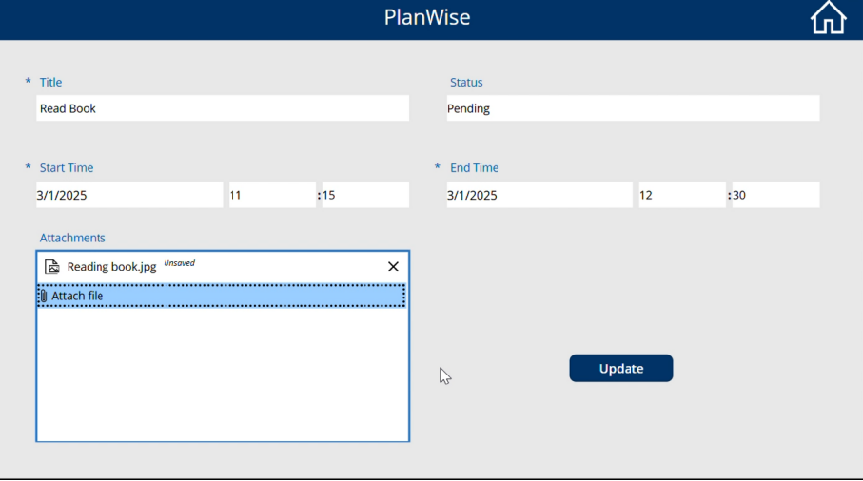
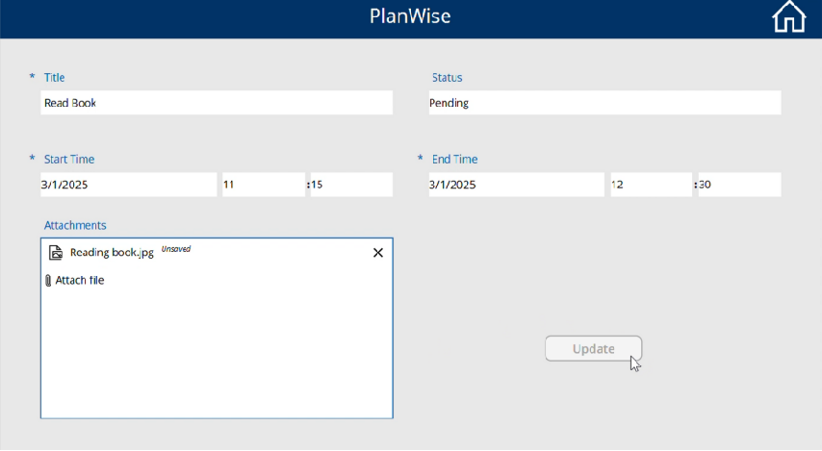
Attach a photo of the task after completion and Update to complete the Task

Slide 11
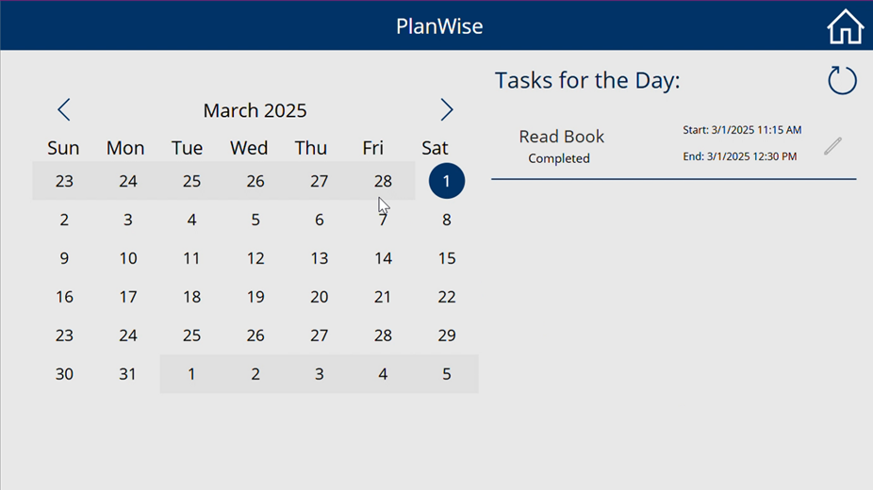
After updating, you are redirected to the Success Screen and then to the Task List
The task is marked as Completed

Slide 12
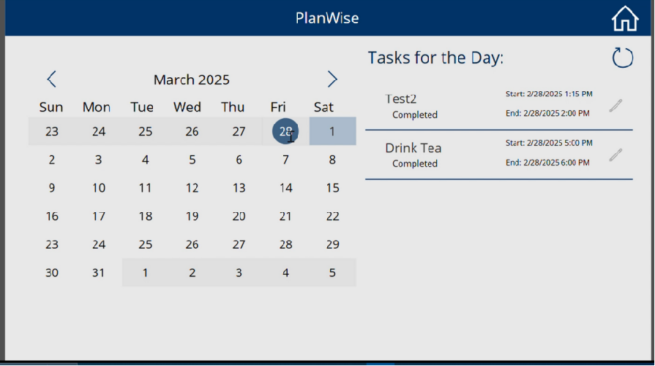
Scroll through the Calendar to view the tasks for any selected date

Slide 13
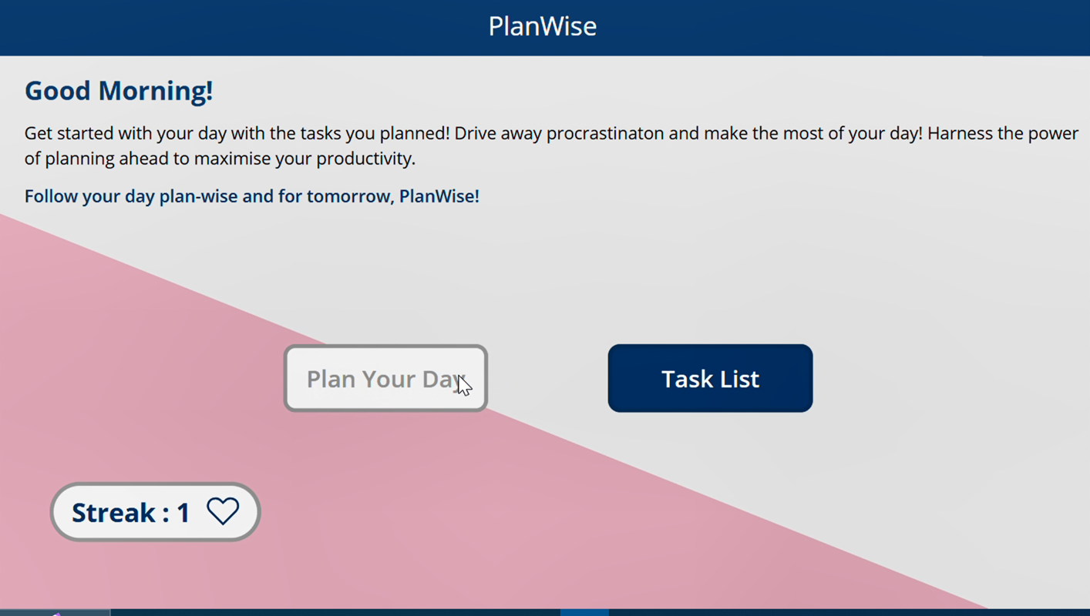
Streak points continue to increase on completing all the tasks planned for a day
If a task is missed on a day, the streak is set to 0

Slide 14
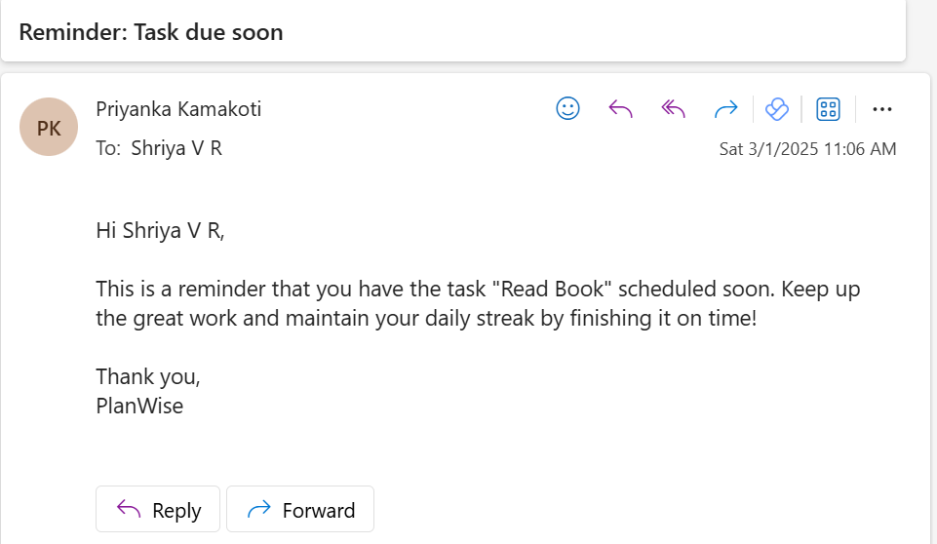
Reminder Email is sent for a heads up!

